Slide 1
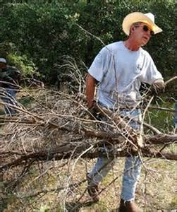
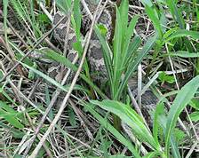
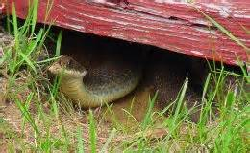
For many people, the very sight of a snake will bring on a full blown panic attack and the majority will do just about anything to make the snake go away. Unfortunately, there is no single method or repellent that will deter all snakes. An effective way to remove snakes is to remove their food source. Clear your yard of stacks of lumber, large rocks, and piles of debris. Mow the grass short, trim the hedges back and remove anything that might be attracting mice or other small rodents. Snake repellents, such as moth balls, can be purchased at your local hardware store. Most snakes are harmless. Learn to identify venomous snakes in your area.

