Slide 1
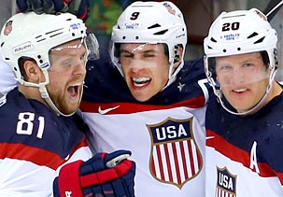
Together Everyone Achieves More
“If everyone is moving forward together as a team, then success will take care of itself”. (Henry Ford)

