Slide 1
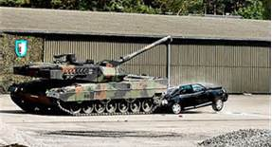
As everyone knows we have equipment and vehicles stored throughout the Base. We have to utilize all of the storage space we have! Much of the stored equipment has to be towed, is very slow moving or has limited operator visibility. When traveling in these areas motorist must use extra caution. Slow down and pay attention to your surrounding.

