Slide 1
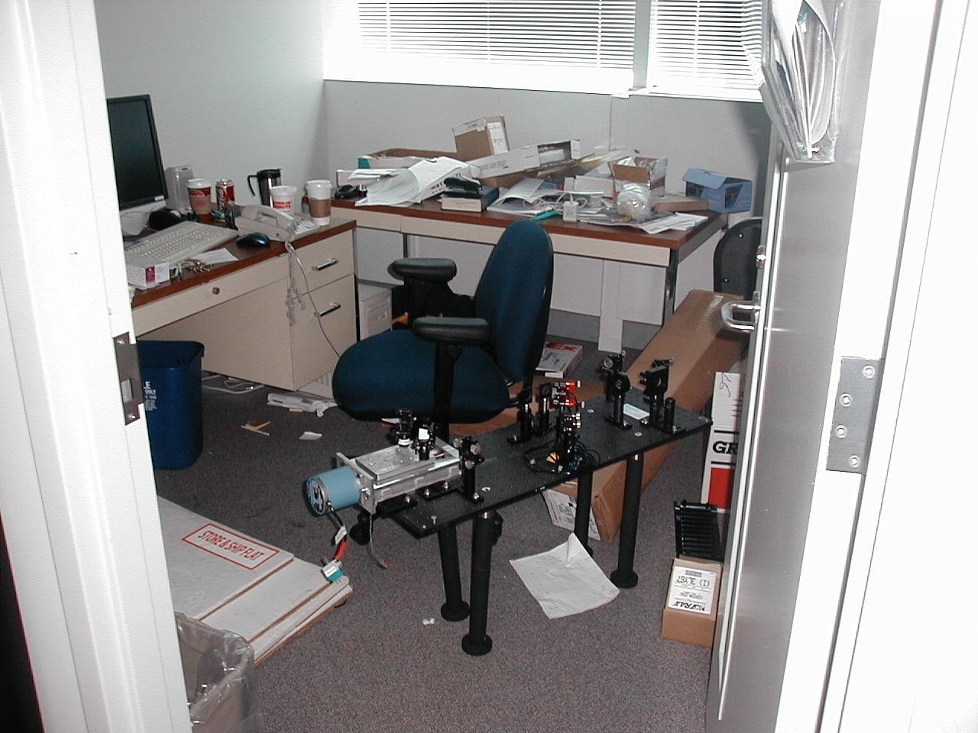
Is this your work space? Well is it?! You’ve got to be kidding me!! Did you know that office workers are twice as likely to be injured by trips and falls than warehouse workers? This snake pit has doubled those odds!! Clean it up!!

