Slide 1
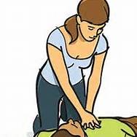
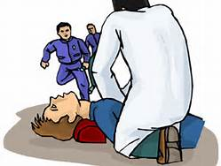
Simple Steps For:
Hands Only CPR
Call 911
Shake patient & Check Breathing
Place hands on center of chest
Keep your arms vertical
Push hard and fast (100 times a minute)
Continue until help arrives
Learn CPR today!

