Slide 1
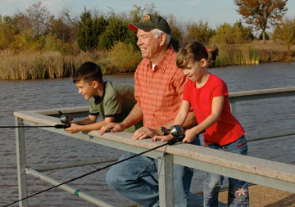
Fishing Safety Tips
Establish rules; No running, Keep your shoes on, and look around before you cast.
Do not allow young children to fish unsupervised.
Make sure each angler, swimmers and non-swimmers alike, wears a life jacket at all times -- on the boat, on the dock, or on the shore.
Bring a long-handled fish net to retrieve fish, trash, or valuables from the water.
Always bring a well-equipped first aid kit.
Take lots of cool water and other healthy drinks to prevent dehydration or even heat stroke.
Protect exposed skin with 25 or higher sunscreen.
Use an insect repellent that contains Deet.
Safety comes first. Look for trouble before it finds you. If it finds you anyway, know how to deal with it. Be alert for snakes and other wild animals.

