Slide 1
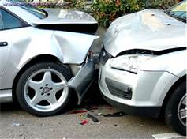
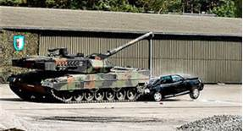
Driver distractions are a major factor in auto accidents. Talking and texting on cells phones are leading causes. In fact, 80% of auto accidents and 65% of near-misses involve some form of driver distraction. Don’t be that driver! Stay alert and don’t get hurt! That’s an Order!

